Slide 1
Processing of 16S rRNA
Amplicon-Sequencing Data
P5
i2
Rd1 SP
515F
16S amplicon 5'
806R
Rd2
SP
i1
P7
Germán Bonilla-Rosso
Garance Sarton
SAGE April 2022

Slide 2
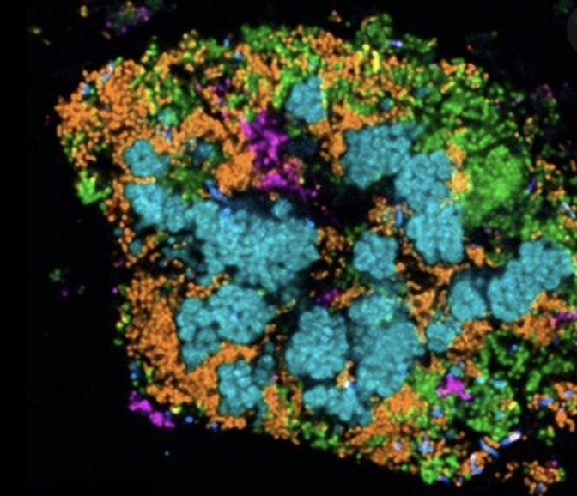
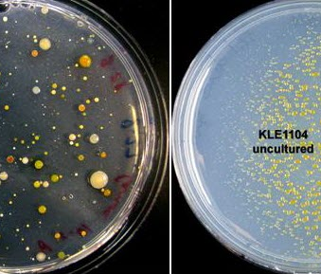
Studying Bacteria...
The Great
Plate Count Anomaly
How do we study organisms that...
- are morphologically indistinguishable?
- are phenotypically redundant?
- are unculturable?
- are uncountable?
- have no clear species boundaries?
wildlife
domesticated
(E. coli)
Notes:
To describe the difference in order of magnitude between the number of cells from natural environments that form colonies on agar plates and the number countable by microscopic examination

Slide 3
Studying Undomesticated Bacteria...
How do we study organisms that...
- are morphologically indistinguishable?
- are phenotypically redundant?
- are unculturable?
- are uncountable?
- have no clear species boundaries?
By sequence phylogenetic analysis of 16SrRNA

Slide 4
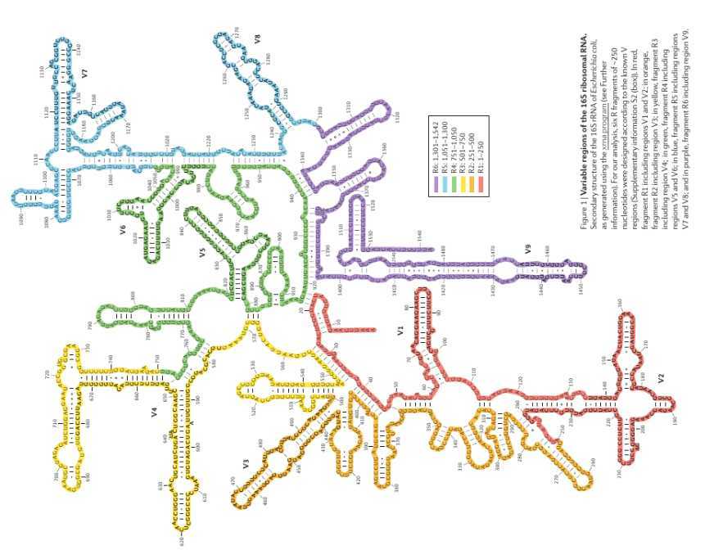
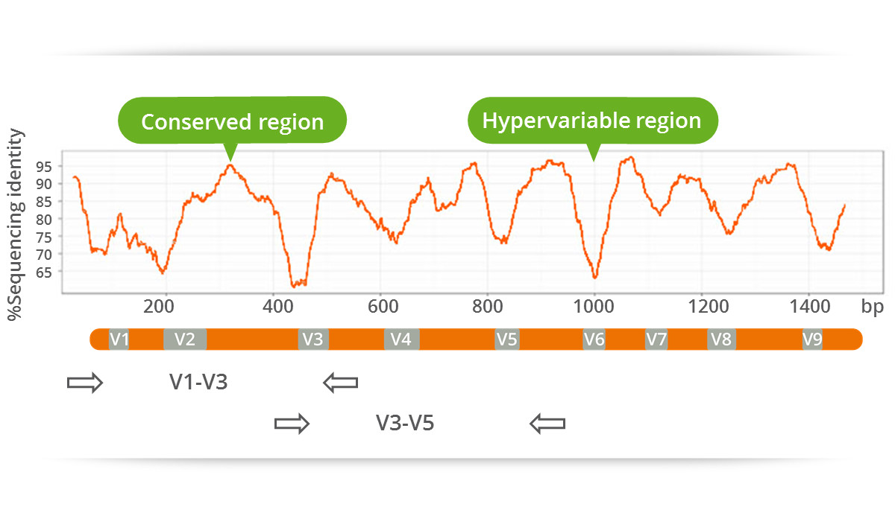
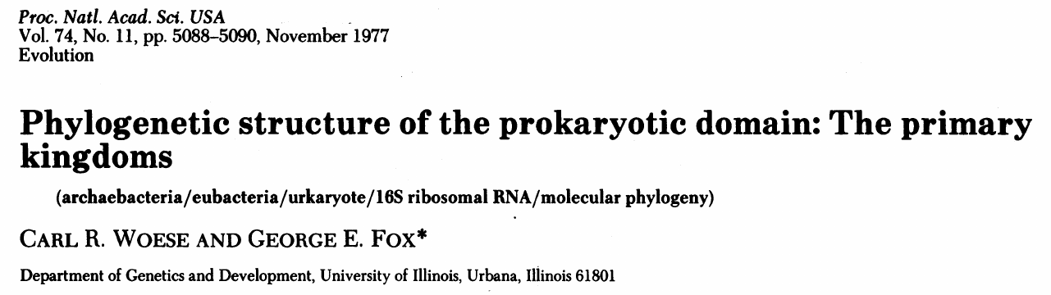
Classifying Domesticated Bacteria...
Use of 16S rRNA sequences to classify bacteria and determine its phylogenetic relationships
We need :
Universally conserved (present in all organisms)
Overall low mutation rate allows comparison of lineages that diverged long ago...
… but with “faster” evolving regions that allow inspection of more recent differences!
Notes:
This paper emphasize on the necessity to have a molecule of a broad distribution to determine the relationshi of the entire spectrum of the living systems. 1977, description and suggestion of a new group, the archaea

Slide 5
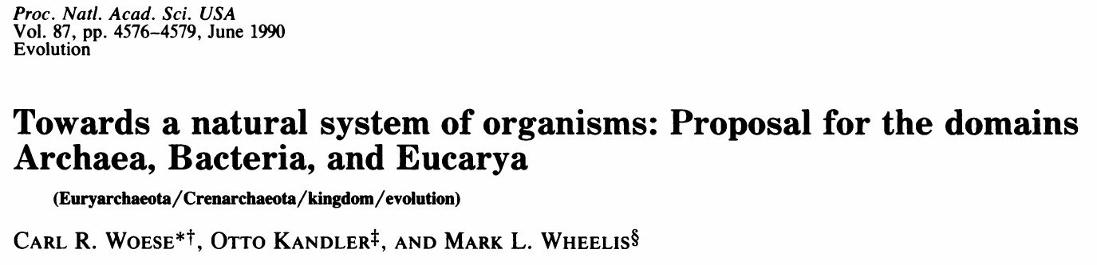
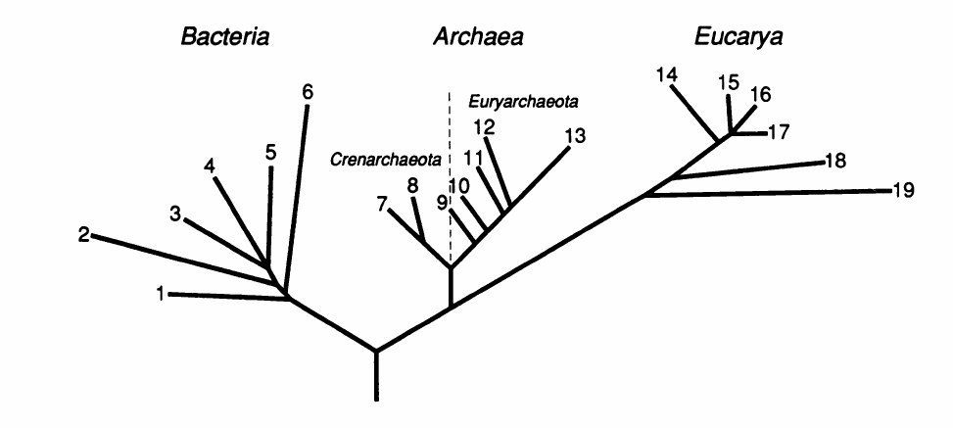
Classifying Domesticated Bacteria...
The Three Domains of Life
Notes:
Period of the five kindomms (Animalia, plantae, Fungi, Protista and Monera –prokaryotes) . They suggested a new level of classification as it was clear for them that a division of life has happened to split the bacteria and the eukaryotes and the animal/plants is secondary divisaion. Above the kingdom, exists a new taxon called domain – Bacteria, Archaea and the Eucarya

Slide 6
Studying Undomesticated Bacteria...
By sequence and phylogenetic analysis of 16SrRNA from isolates
How do we study organisms that...
- are morphologically indistinguishable?
- are phenotypically redundant?
- are unculturable?
- are uncountable?
- have no clear species boundaries?
By sequence and phylogenetic analysis of 16SrRNA from environmental samples
Notes:
Now the last question, how do we study organisms that have no clear species boundaries ?

Slide 7
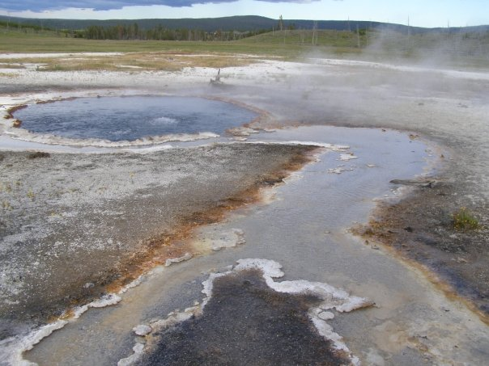
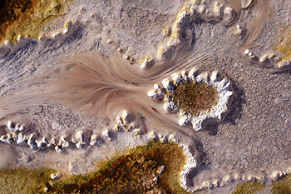

Classifying undomesticated Bacteria...
pink filamentous bacteria from Octopus Spring, Yellowstone
Skip culturing and characterizing,
direct DNA extraction and sequencing of rRNA
(Norman Pace & David Stahl, 1981)
...before PCR!!!
Notes:
Sequenced the 5S, the
86-88 first PCR

Slide 8
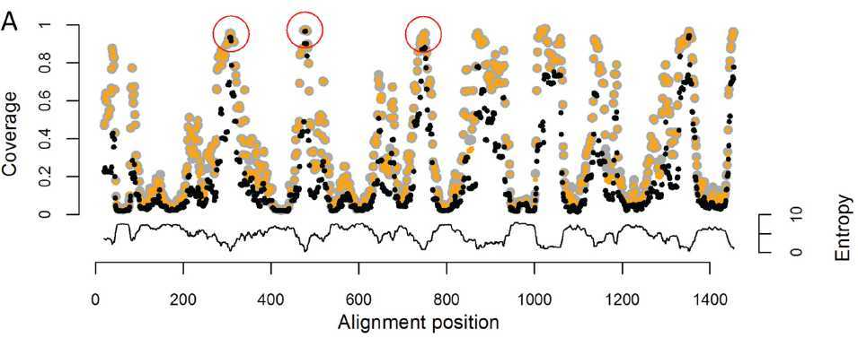
Dissection of 16S rRNA
Design primers in the conserved regions...
… and amplify the variable regions!

Slide 9
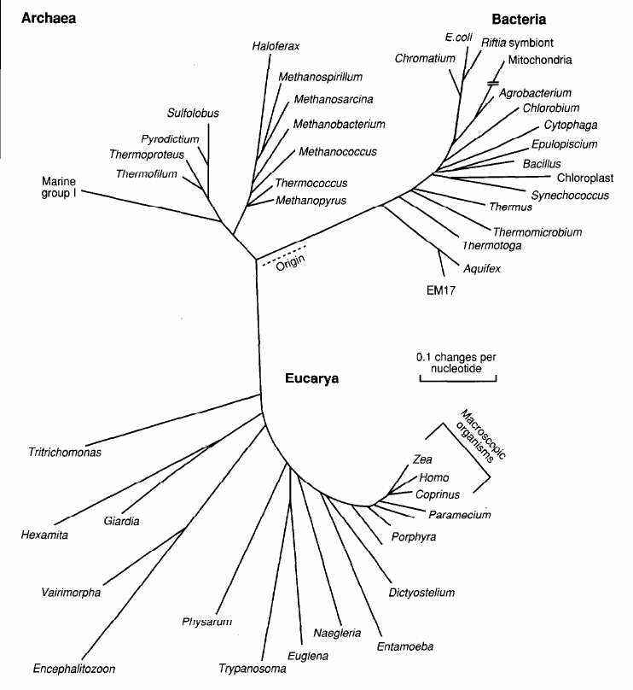
Classifying undomesticated Bacteria...
Sequencing of 16S rRNA from environmental DNA led to an explosion of discovery of novel bacterial and archaeal lineages... in individual samples!
Notes:
Some samples are only characterised by their 16S.

Slide 10
Studying Undomesticated Bacteria...
By sequence and phylogenetic analysis of 16SrRNA from isolates
How do we study organisms that...
- are morphologically indistinguishable?
- are phenotypically redundant?
- are unculturable?
- are uncountable?
- have no clear species boundaries?
By sequence and phylogenetic analysis of 16SrRNA from environmental samples
By sequence similarity of the FULL LENGTH of 16SrRNA

Slide 11

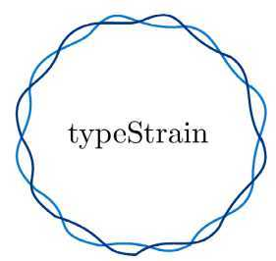
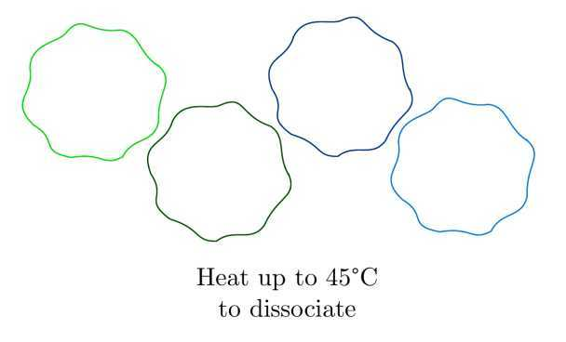
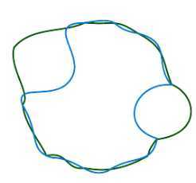
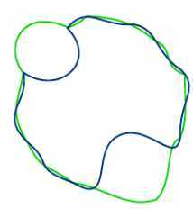
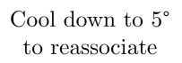
Determining if two strains are the same, 70's style…
DNA-DNA hybridization test...
>70% reassociation AND stable at 5 C
is the same species
>80% reassociation
is the same subspecies
Notes:
After reassociation, the % of reassociation is measured by the melting profile of the hydridized DNA -> DNA is heated step by step, wash the column at each step and melted sequences are single stranded and wash of the column. The temperature of wash off reflects the amount of similarity (the higher the similarity the greater amount of energy you need).

Slide 12
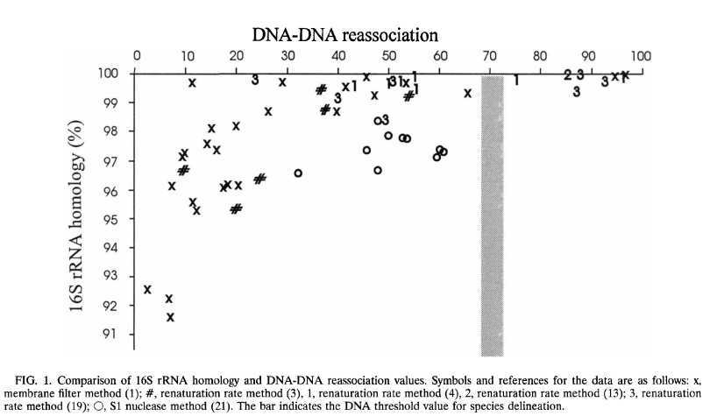
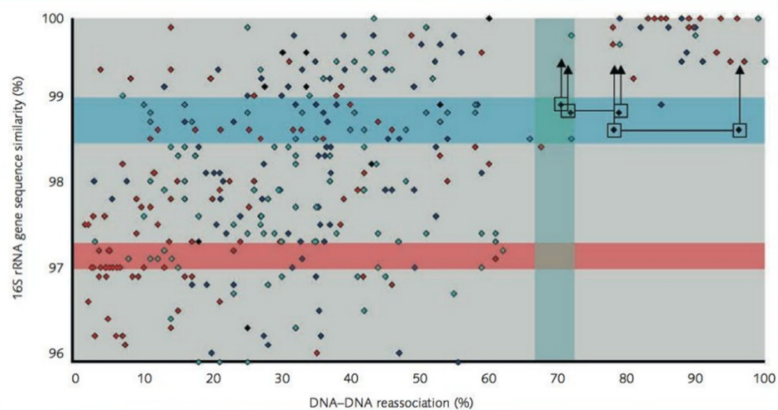
The 97% “Golden Standard”
red: microtitre plate technique
dark blue: spectrophotometric technique
light-blue: membrane filter method
black: other
“...below a threshold value of 98.5% sequence similarity, the corresponding DNA reassociation values were always lower than 70%.”
“... reassociation experiments need only be performed for strains that shared 16S rRNA gene sequence similarities higher than 98.7-99%”.
“... rare examples may exist […] in which reassociation values >70% emerge at corresponding 16SrRNA similarities ~99%”.
[Stackebrandt & Goebel 1994]
“One can nevertheless argue that organisms which have >70% DNA similarity will have at least 97% sequence identity.”
“...at sequence homology values below 97.5%, it is unlikely that two organisms have more than 60 to 70% DNA similarity and hence that they are related at species level.”
[Stackebrandt 2006]
[Stackebrandt & Goebel 1994]
Notes:
How do you link the hybridization test and the similarity in the 16S ?
Arrows point to the position of in silico-recalculated binary 16S rRNA gene sequence similarity values of sequences deposited by Amakata et al. (2005)
The horizontal blue bar indicates the threshold range above which it is now recommended to perform DNA–DNA reassociaton exps

Slide 13
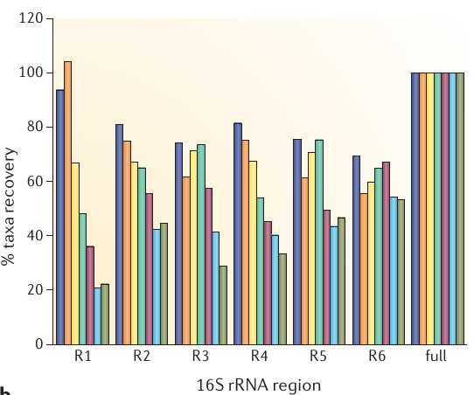
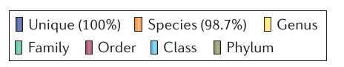
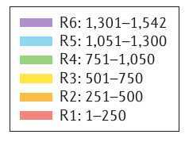
Limitations of 16S rRNA for taxonomic determination
Yarza et al. 2014
Notes:
Study which used all the available 16S sequences from the living tree project, 8600. They designed 6 fragments of – 250 nucleotides and analysed the accuracy of predicting taxonomic thresholds and richness estimates from partial sequences

Slide 14
Limitations of 16S rRNA for taxonomic determination
The 97-98.5% golden threshold is considering the FULL LENGTH...
if you amplify a fragment, you just have NOT ENOUGH resolution at species/subspecies level!!!!
Yarza et al. 2014

Slide 15
Amplicon-Sequencing

Slide 16
Library Preparation
341-5'
515-3'
genomic V3-V4 Region
F
PCR target
R
a1
F
16S amplicon
R
a2
tags / adapters
PCR amplification primer
5'-ACACTCTTTCCCTACACGACGCTCTTCCGATCT-NNNN-fwd_primer-3'
5'-AGACGTGTGCTCTTCCGATCT-rev_primer-3'
Notes:
The method is to use a two step PCR protocol, the first PCR step is used to amplify the region of interest with target specific primers.

Slide 17
Library Preparation
a1
F
16S amplicon
R
b2
P5
i2
a1
F
16S amplicon
R
b2
i1
P7
16S
16S amplicon
b2
b2
P7
P5
P7
P5
i1
i2
F
a1
F
a1
R
R
i2
i1
Flow-cell
binding region
Index / barcode
(sampleID)
Adapter region binding
Sequencing Primer
Notes:
the universal sequences CS1 and CS2, which provide the bases used in. the second PCR to extend the amplicons with Illumina adapters and sample-identification barcodes.

Slide 18
Anatomy of an Illumina Template
Binding Regions: complementary to the Flow Cell sequences
Index: biological sample identifier, allows you to multiplex
SP binding: attachment sites for Sequencing Primers
Random Ns: to improve sequencing and clustering
UserPrimer: this is the primer you used for gene amplification
P5
i2
Rd1 SP
515F
16S amplicon 5'
806R
Rd2
SP
i1
P7
19bp
20bp
292 bp

Slide 19
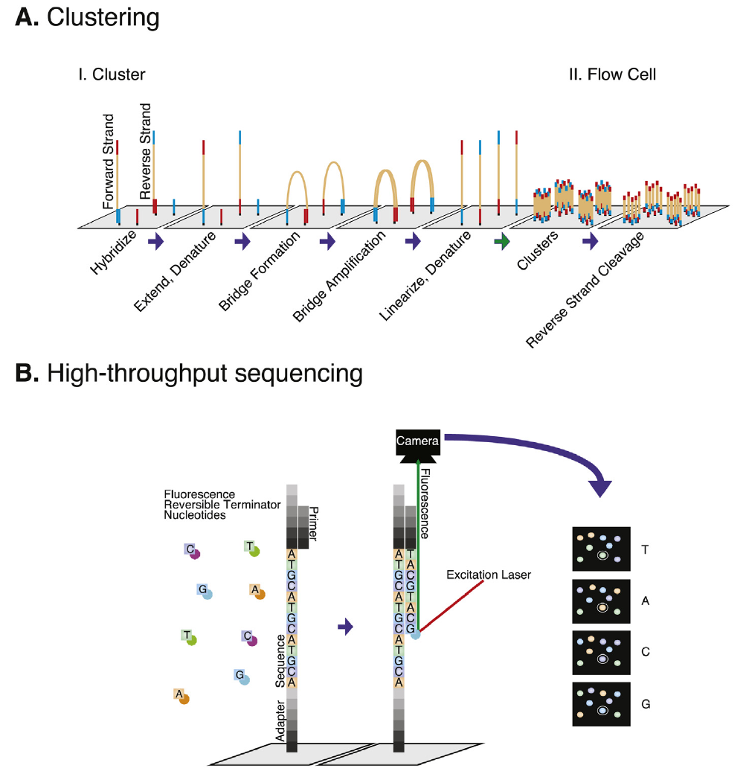
Illumina
Sequencing

Slide 20
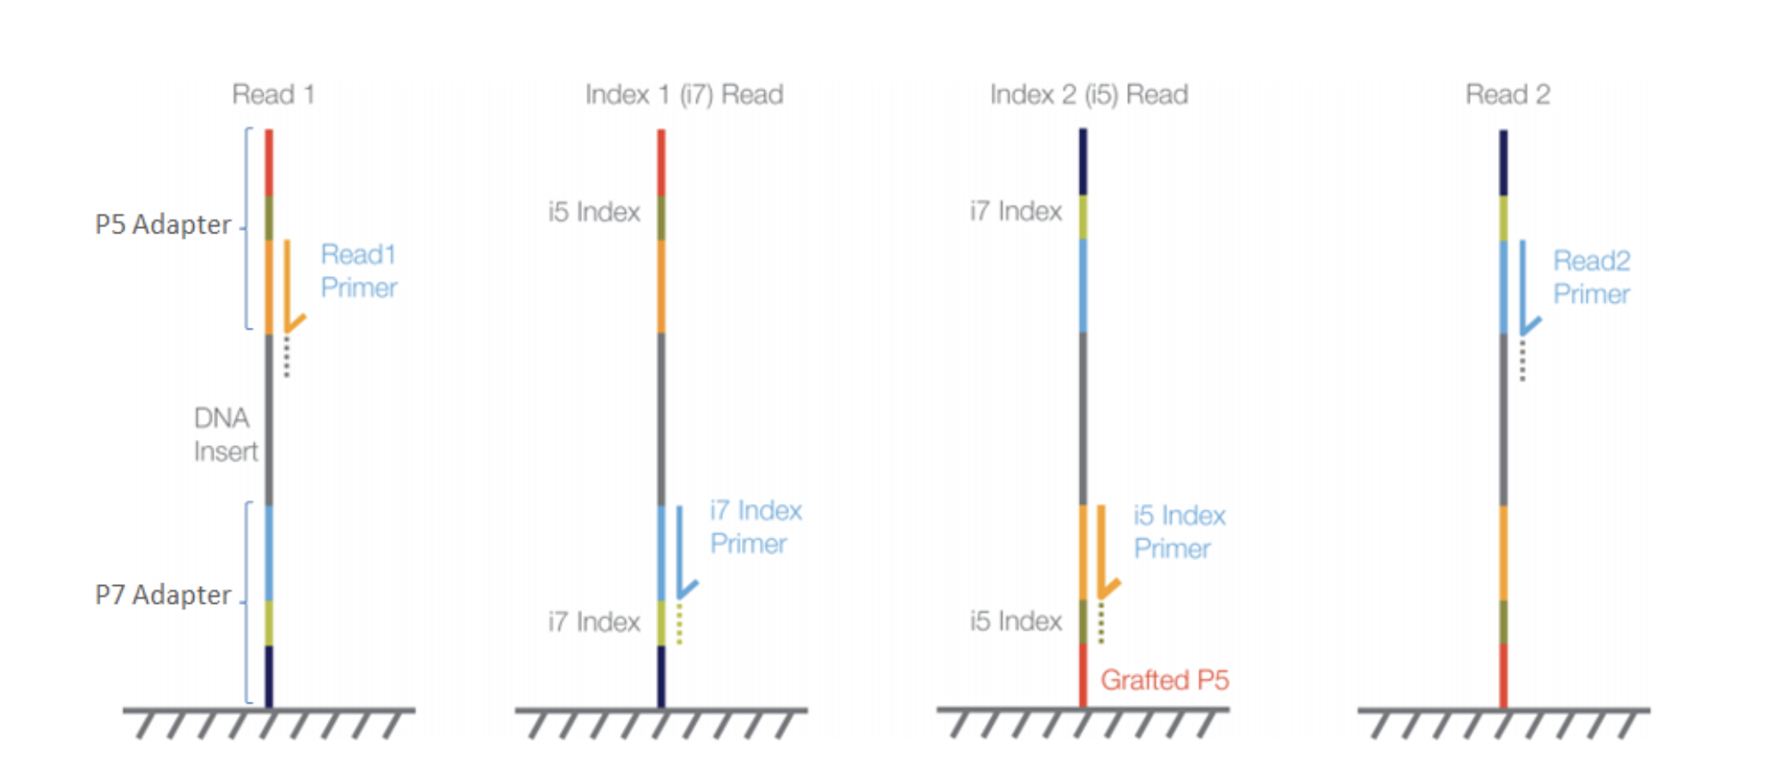
Illumina
Sequencing

Slide 21
Anatomy of an Illumina Read
292 bp
SP1
250 bp
6 bp
P5
i2
Rd1 SP
F
16S amplicon
R
Rd2SP
i1
P7
6 bp
250 bp
SP2
196 bp - overlap
Read 1 (Forward)
i1
515F
16S amplicon
Read 2 (Reverse)
i2
806R
16S amplicon

Slide 22
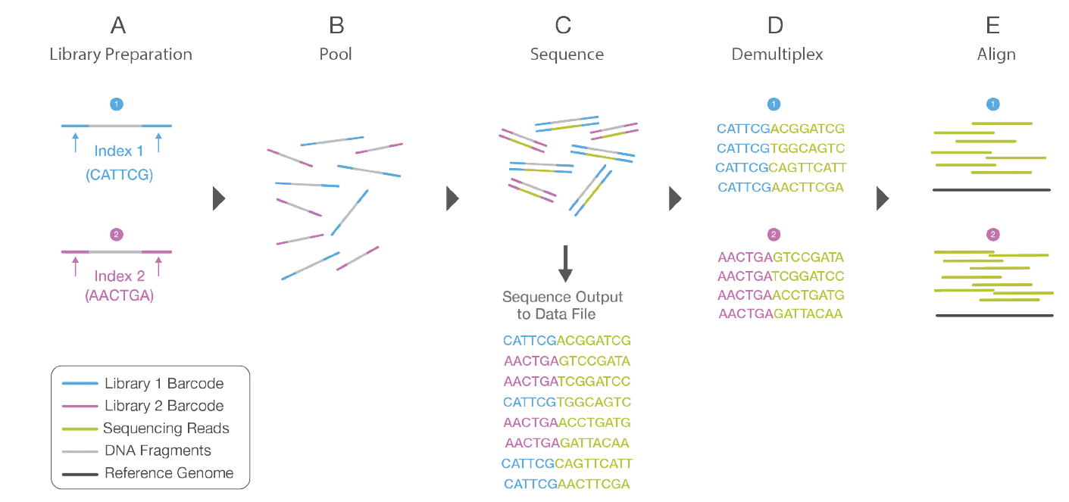
Amplicon Sequencing - Multiplexing
Notes:
To do multiplexing, 2 step PCR

Slide 23
Possible Problems
292 bp
196 bp
SP1
250 bp
6 bp
P5
i2
Rd1 SP
F
16S amplicon
R
Rd2SP
i1
P7
i1
515F
16S amplicon
i1
515F
Shorter insert
Rd2SP
i1
P7
i1
515F
Shorter insert
Rd2SP
i1
P7
i1
515F
Shorter insert
Rd2SP
i1
P7
If the amplicon insert is shorter than expected, then the read can extend beyond the end of the amplicon, and sequence the adapters on the other end

Slide 24
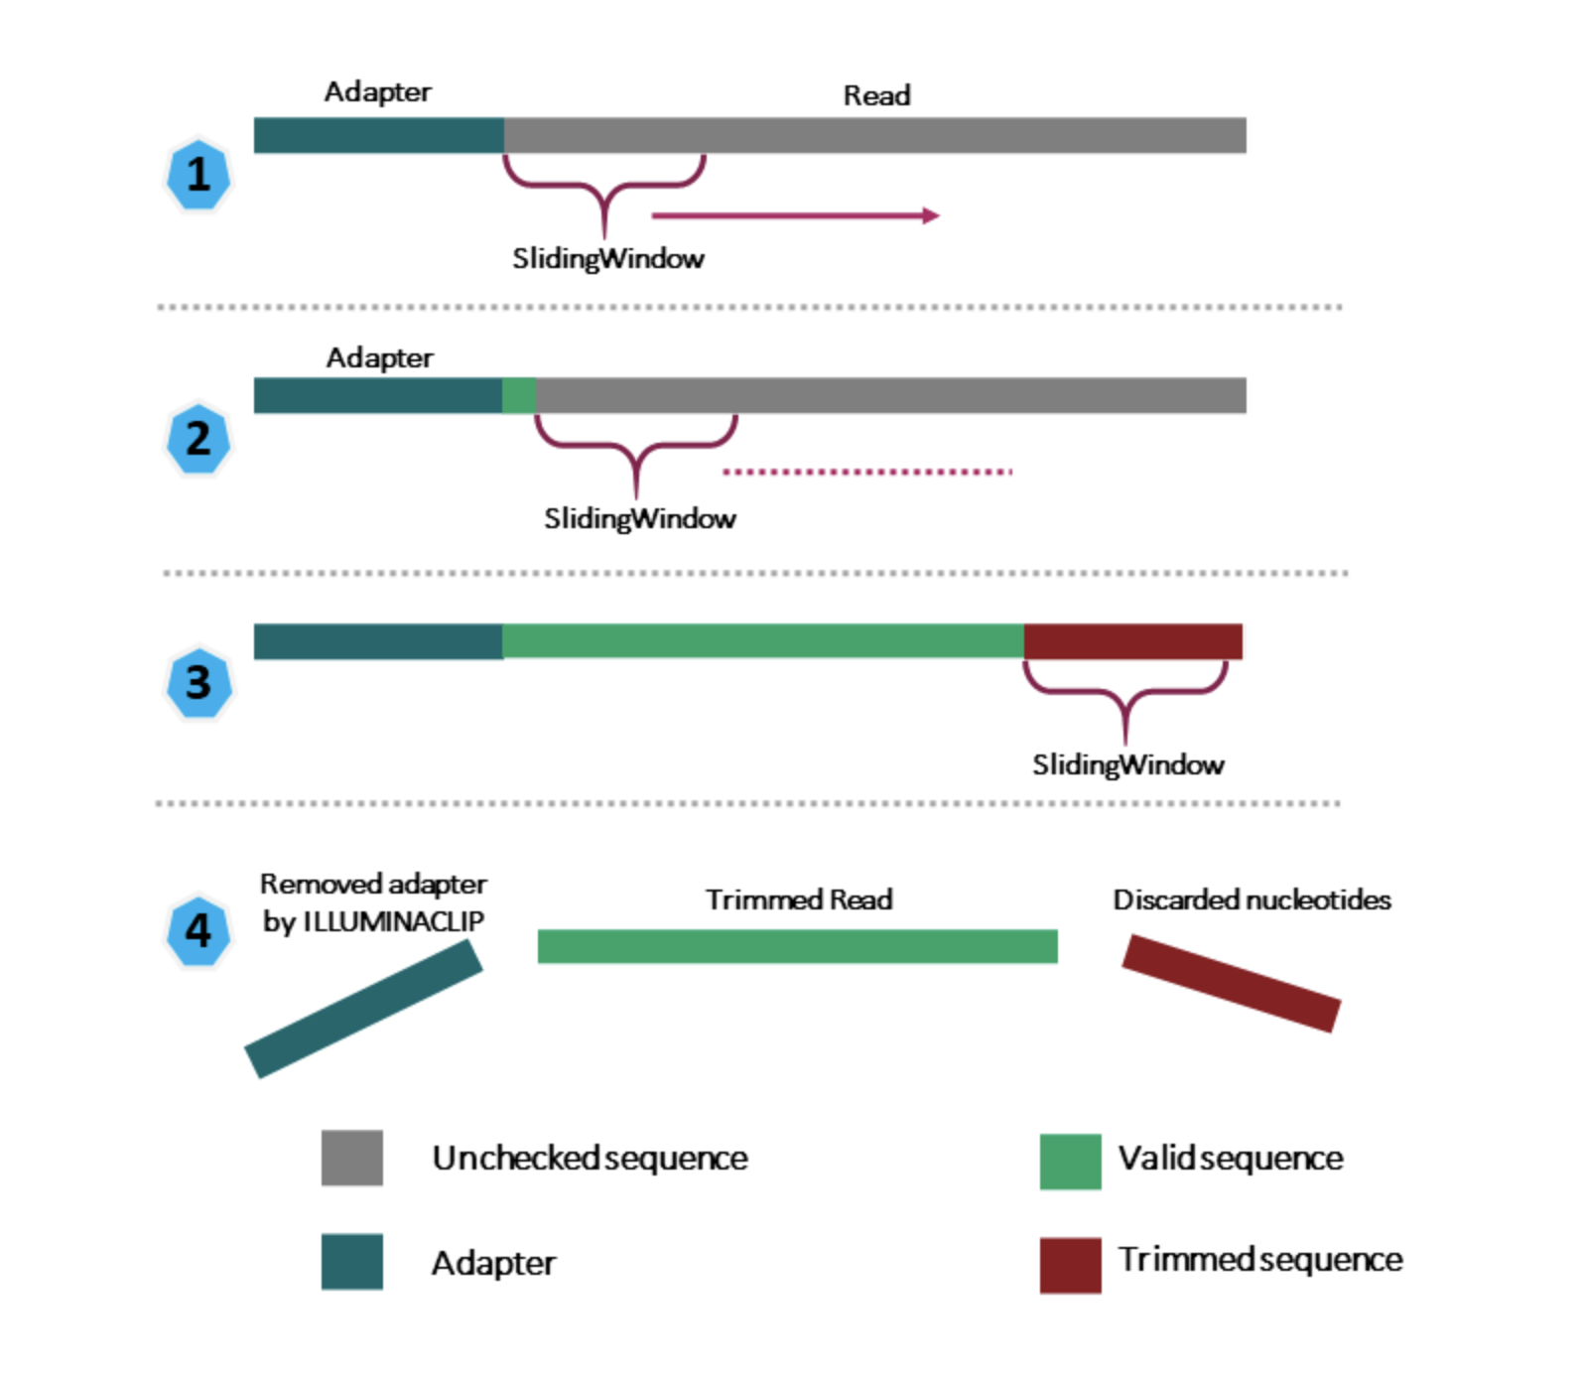
Trimmomatic
https://carpentries-incubator.github.io/metagenomics/03-trimming-filtering/index.html

Slide 25
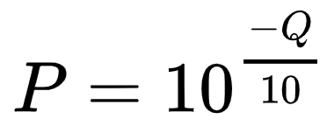
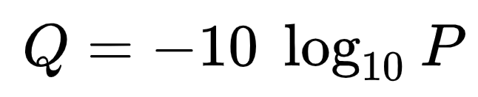
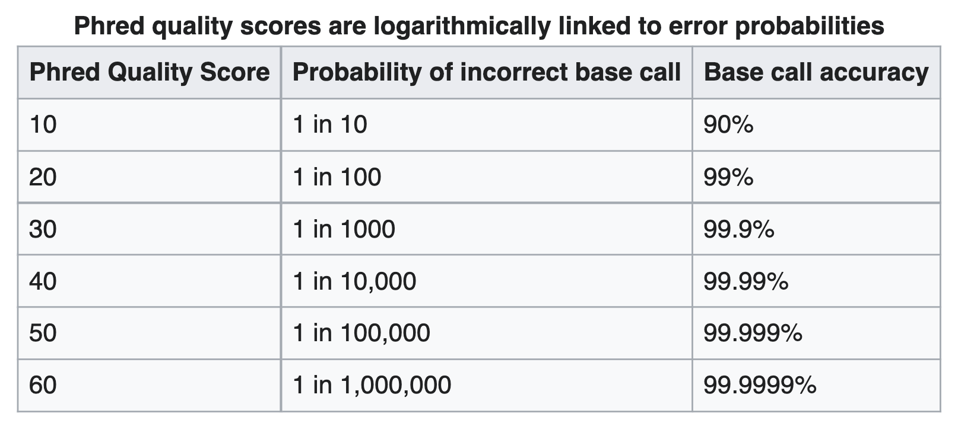
Q-score
For each base call, NGS sequencing apparatuses calculate the probability of a base-calling error (P) considering intensity, signal-to-noise ratios, cluster quality etc, into a quality score (Q-score or Phred score).

Slide 26
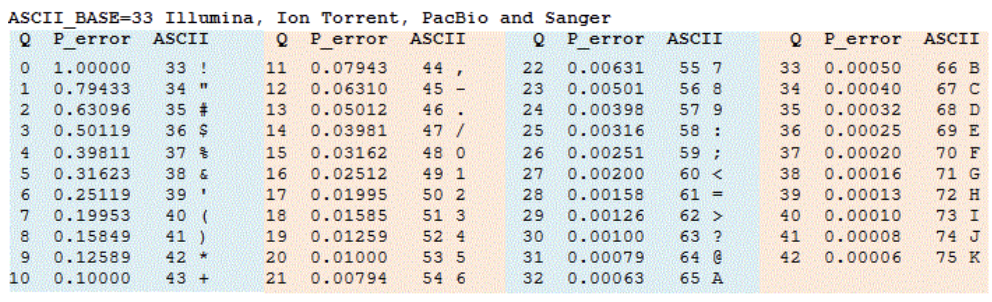
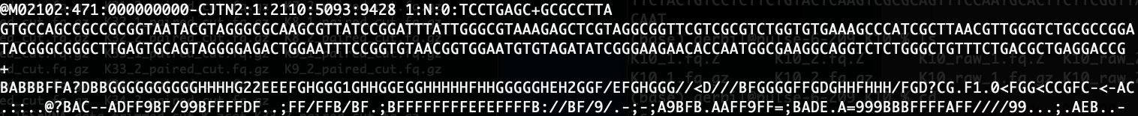
Q-score
To save space, Q-scores are represented in ASCII code, and this is what you actually see in your FASTQ files as the quality score!

